Slide 1

CLIMATE-O-METRIC
TEAM MEMBERS:-
1)BANDLA SAI VINAY CHAKRAVARTHI
2)MABHU SUBHANI SHAIK
GOOGLE-DRIVE-LINK

Slide 2
1.What is sustainability?
Sustainability is the act of meeting current needs without compromising the ability of future generations to meet their own needs. It strongly emphasizes maintaining an adequate balance between environmental preservation, economic development, and social well-being in the process of viability and equity in the long term.
2.How the journey towards sustainable future has been for countries?
The path to sustainability has had both successes and difficulties. Many countries have made important progress in using renewable energy, with solar, hydro, and biofuel production increasing steadily since the 1990s. However, growing energy use and ongoing air pollution show that progress is not equal, especially in cities and industrial areas. Efforts at forest conservation and carbon sequestration have been promising, but deforestation and carbon emissions are still big challenges. Climate data points to the urgency for action as rising temperatures have continued impacting ecosystems and societies across the world.
3.What are your recommendations for future?
Countries should hasten the use of renewable energy through investment in technologies like solar panels and geothermal energy, besides encouraging energy-saving practices. Strong pollution rules and better city planning significantly fight air pollution. Enhanced efforts at worldwide forest conservation can add to the great improvement of carbon capture. Besides, the use of climate data in policy-making and joining forces with other countries will, therefore, ensure fair and successful progress toward realization of a sustainable future.

Slide 3
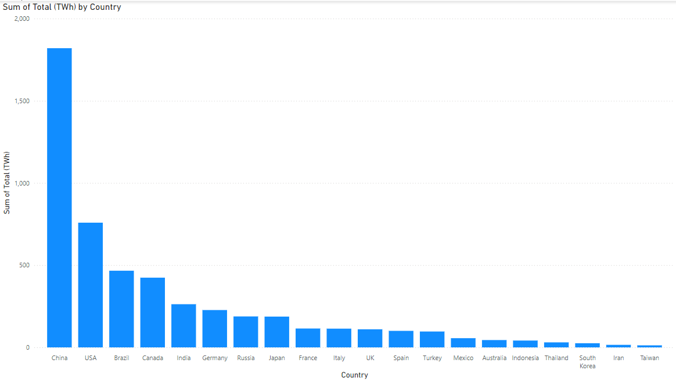
Top 20 countries Power generation
The dataset is power generation-based, which incorporates different sources of renewable energy like hydro, biofuel, solar, and geothermal. It reveals the production and distribution levels of these renewable energy sources. The data is designed to facilitate analysis and comparison of these categories. This would be helpful in effectively understanding and making decisions in the usage of renewable energy.

Slide 4
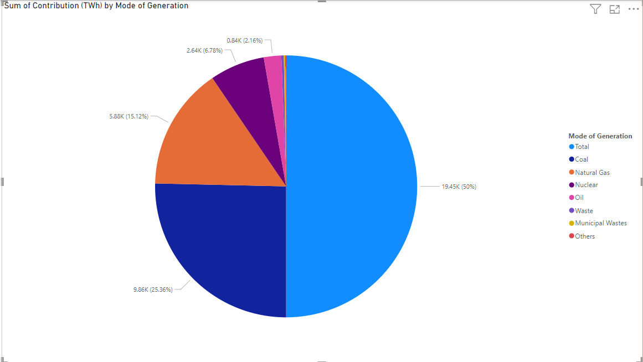
Non-renewable Total power generation
It also provides information on the mode of power generation, which further details its contribution measured in terawatt-hours. This shows the share of each generation type, and that makes it easier to present an energy production scale with clarity. Such data is crucial in assessing the efficiency and impact of different sources of energy.

Slide 5
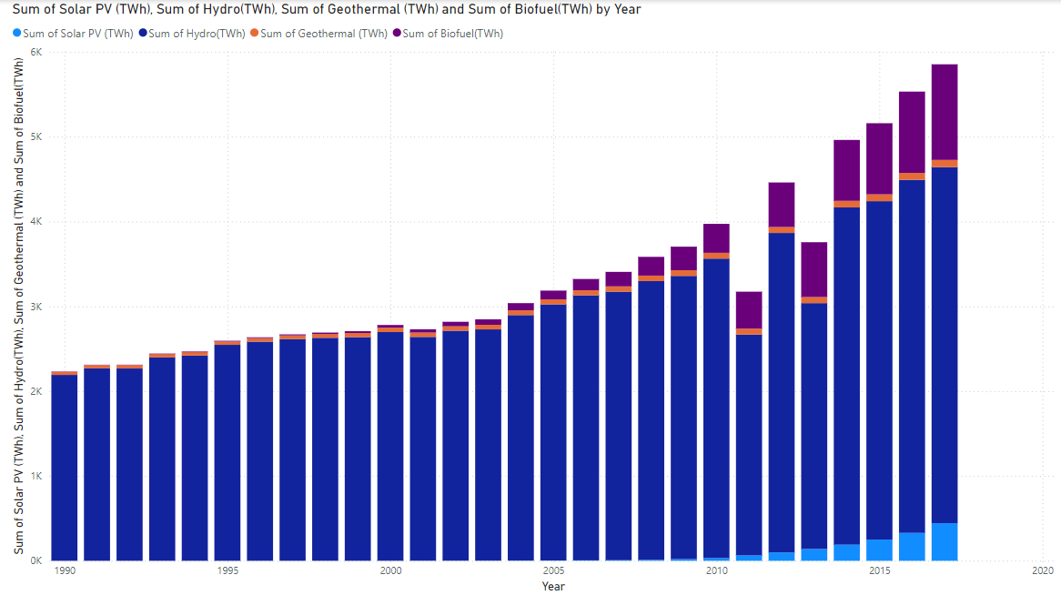
Renewable Power Generation
The Renewable Power Generation dataset ranges from 1990 to 2017 for hydro, biofuel, solar PV, and geothermal energy production. In this manner, it would provide an all-around look at the trends of renewable energy nearly over three decades. This is important in analyzing the increase and change in the pattern of using renewable energy in the passage of time.

Slide 6
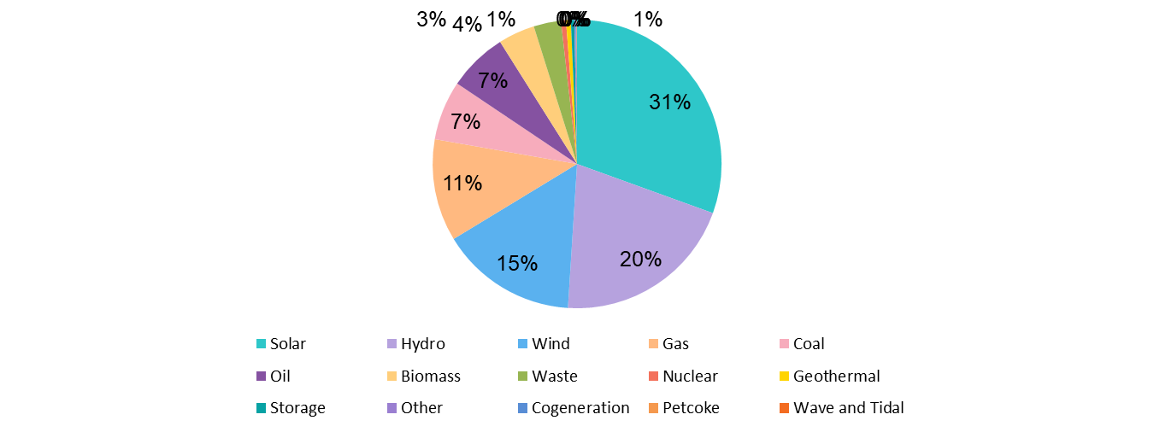
Global Power Plants
The data reveals that Solar power leads with 10,665 power plants, followed by Hydro with 7,156 and Wind with 5,344. Traditional energy sources like Gas and Coal have 3,998 and 2,330 plants, respectively. Notably, Nuclear energy has only 195 plants, indicating a smaller footprint compared to renewable sources. Emerging technologies like Wave and Tidal are at the nascent stage with just 10 plants. This highlights a significant shift towards renewable energy, with solar power being the most prevalent.

Slide 7
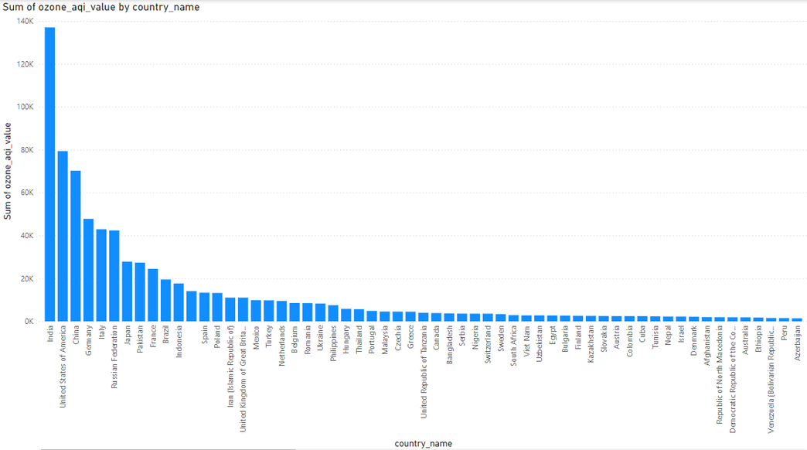
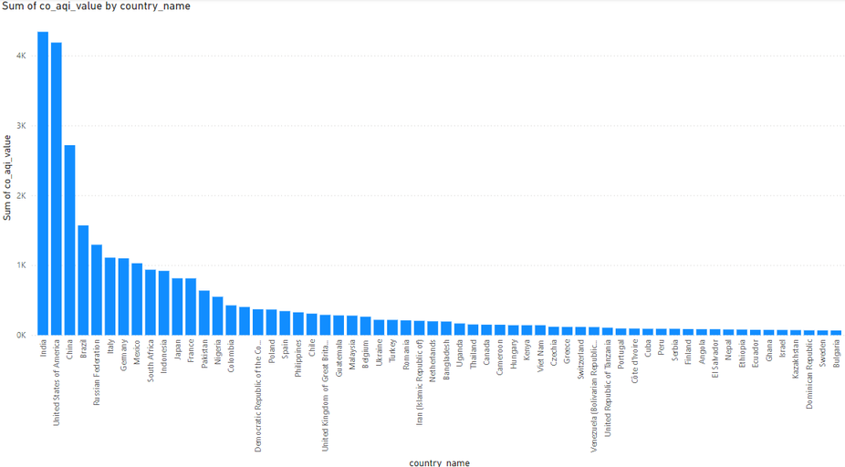
Global air pollution
The Global Air Pollution dataset provides AQI values for key pollutants: CO, Ozone, NO₂, and PM₂. It offers a more detailed perspective on air quality by measuring pollutant concentrations. This dataset is very important for the study of pollution trends and their environmental and health impacts around the world.

Slide 8
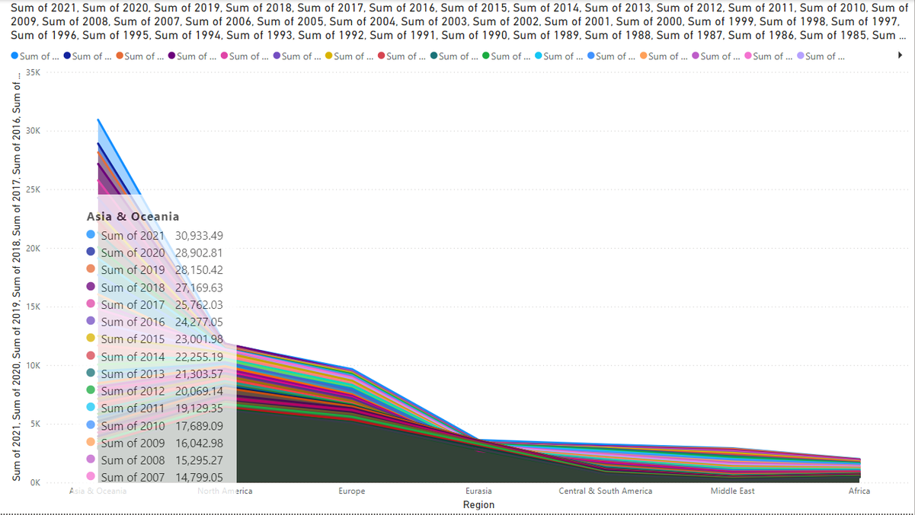
Global Electricity Statistics
The Global Electricity Statistics dataset spans from 1980 to 2021 and includes data segmented by regions. It provides insights into electricity production, consumption, and trends over four decades. This dataset is crucial for understanding regional energy dynamics and long-term shifts in global electricity usage.

Slide 9
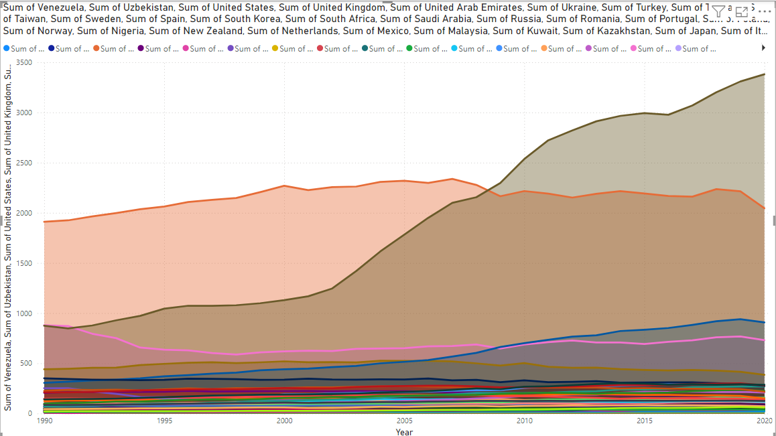
Country consumption
Our Company
The dataset ranges from the year 1990 to 2020 and gives a total of electricity consumption in TWh for different countries. This data is invaluable for determining the national pattern of consumption over three decades of time. It is used to compare the demand for global energy consumption and consumption by countries.

Slide 10
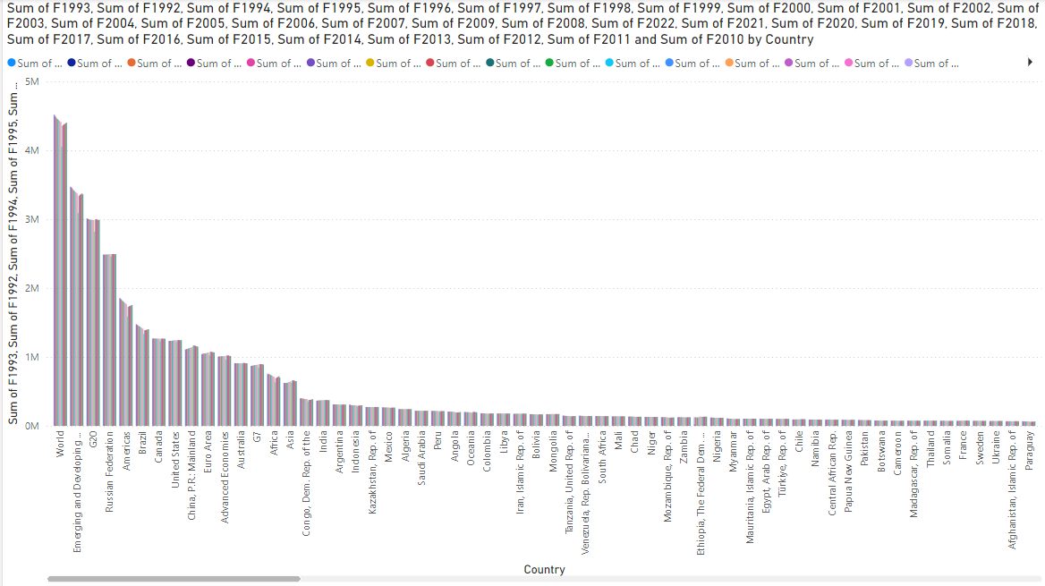
Forest and Carbon
The Forest and Carbon dataset ranges from 1992 to 2022 covering countries, indicators, and measurement units. This dataset gives insights into the metrics of forests related to carbon dynamics over three decades. It is very critical in studying the relationship of forests with carbon emissions or sequestration globally.

Slide 11
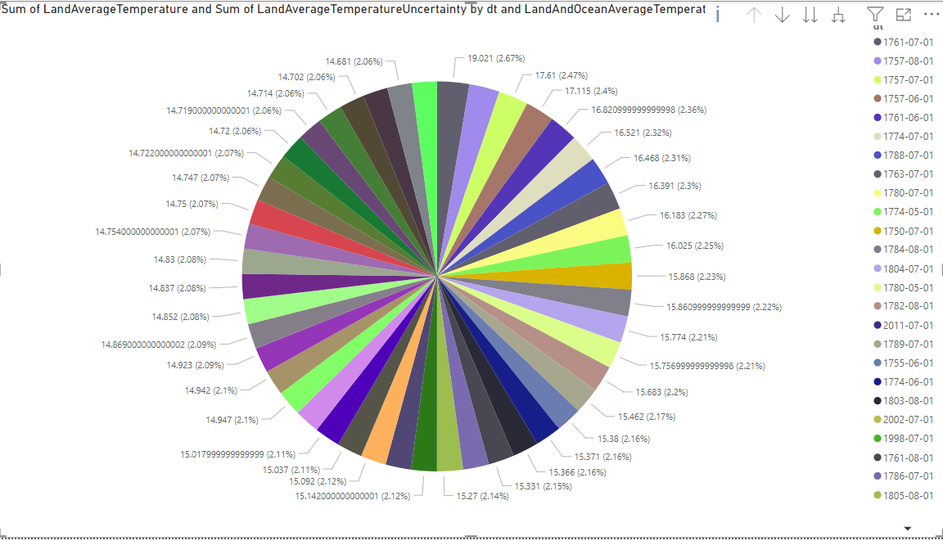
Global Temperatures
The Global Temperatures dataset consists of dates (dt) and also contains land average temperatures, their uncertainties, and land maximum and minimum temperature uncertainties. It has a comprehensive record of temperature variations and measurement reliability. This dataset is therefore very important in analyzing climate trends and the fluctuations in temperature over time.

